Slide 1
GIT FUNDAMENTALS

Slide 2
AGENDA
WHAT IS GIT?
FUNDAMENTALS
CLONE REPOSITORY
SAVE CHANGES
REVERT AND REVERSE
USING BRANCHES
FETCH AND PULL
MERGE
MERGE CONFLICTS
REBASE
CHERRY PICK
PULL REQUEST
EXERCISE

Slide 3
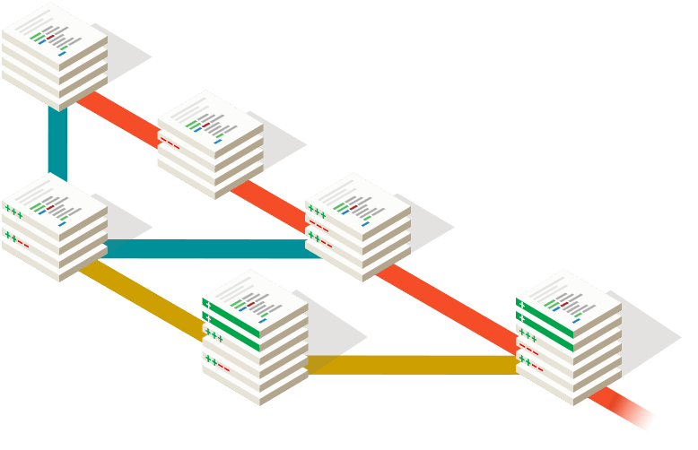

WHAT IS GIT?
Git is a version control system for tracking changes in computer files and coordinating work on those files among multiple people

Slide 4

FUNDAMENTALS

Slide 5
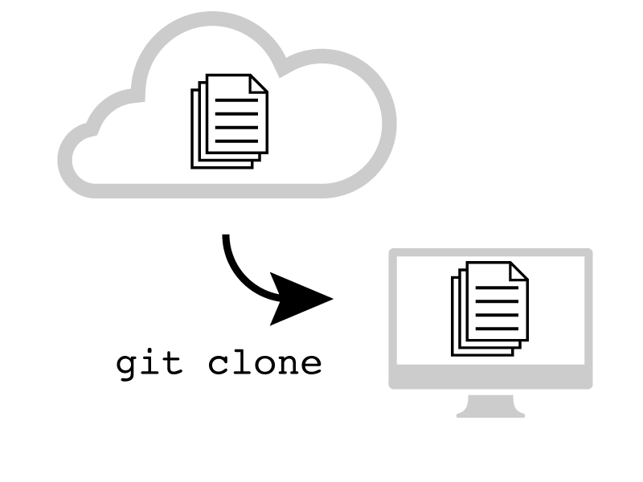
CLONE REPOSITORY
$ git clone url_repository
/path/repository
file:///path/repository
url

Slide 6
SAVE CHANGES
git add
git push
working copy
staging
local repo
remote repo
git commit

Slide 7
SAVE CHANGES
$ git add <file-name>
$ git add <directory-name>
$ git add .
$ git commit
$ git commit – m "comment"
$ git push
$ git push <remote> <branch>​
​

Slide 8
REPOSITORY INSPECT
$ git status
On branch TEST-123
Changes to be committed:
(use "git reset HEAD <file>..." to unstage)
new file: cucumber/src/test/features/sendprices.feature
Changes not staged for commit:
(use "git add <file>..." to update what will be committed)
(use "git checkout -- <file>..." to discard changes in working directory)
modified: java/src/main/model/prices/Price.java
$ git log
$ git log –-oneline

Slide 9
REPOSITORY INSPECT
$ git log
commit e4c7d109ce97c28e1063157d394362672678cc5f
Merge: 7ea5032 6d335bf
Author: Gabriel Giri <31039049+gabrielgiri@users.noreply.github.com>
Date: Thu Jan 31 10:18:13 2019 -0300
Merge pull request #2 from gabrielgiri/menutranslate
Menutranslate
commit 6d335bfdfd00109fc81c05582974b56e0f97ae02
Author: Gabriel Giri <gabrielgiri@gmail.com>
Date: Thu Jan 31 10:14:19 2019 -0300
removed extra ooo
…

Slide 10
REPOSITORY INSPECT
commit 73d1bcc021629122fef184605404fdd740f5ba2f
SHA -1
40 characters
Integrity
Id

Slide 11
REVERT AND REVERSE – CHECKOUT
a1b8gte
b1b8la9
e30213
33d805
Master
HEAD

Slide 12
REVERT AND REVERSE – CHECKOUT
$ git checkout e30213
a1b8gte
b1b8la9
e30213
33d805
Master
HEAD

Slide 13
REVERT AND REVERSE – CHECKOUT
$ git checkout <commit>
$ git checkout HEAD
$ git checkout <branch>
$ git checkout -b <new branch>
…

Slide 14

REVERT AND REVERSE – REVERT
a1b8gte
b1b8la9
33d805
Master
HEAD

Slide 15

REVERT AND REVERSE – REVERT
$ git revert b1b8la9
a1b8gte
b1b8la9
33d805
43d805
Master
HEAD

Slide 16
REVERT AND REVERSE – REVERT
>_ git revert <commit>
>_ git revert HEAD

Slide 17
REVERT AND REVERSE – RESET
a1b8gte
b1b8la9
7a134d
33d805
Master
HEAD

Slide 18
REVERT AND REVERSE – RESET
$ git reset 7a134d
a1b8gte
b1b8la9
7a134d
Master
HEAD

Slide 19
REVERT AND REVERSE – RESET
$ git reset <commit>
$ git reset HEAD
…

Slide 20
EXERCISE
We already are prepared for our first exercise. It's pretty simple; we want to display a todo list for this session, you only need follow below steps:
Clone the repo: https://github.com/gabrielgiri/endava-git-training.git
Create a new branch from master with your name
$ git checkout -b <firstName><lastName>
Create a new text file with your personal info (<firstName><lastName>.txt) in the users folder with your info:
1nd line: first name
2rd line: last name
3th line: role
4th line: your 3 Main hobbies separated by a comma
Push your file on your branch, verify with git status
Request a Code Review on github
Once approved, merge to master

Slide 21
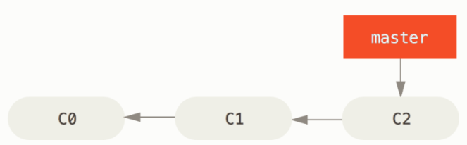
BRANCH
$ git checkout -b iss53
Switched to a new branch "iss53"

Slide 22
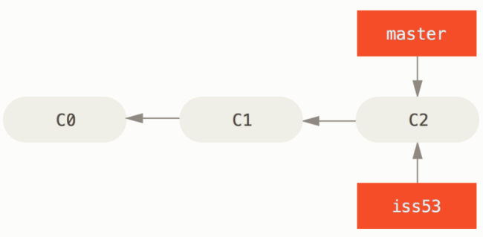
BRANCH
$ git branch iss53
$ git checkout iss53

Slide 23
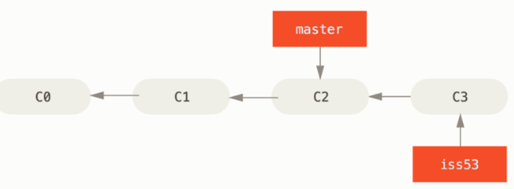
BRANCH
$ vim index.html
$ git add --all
$ git commit -m 'added a new footer [issue 53]'

Slide 24
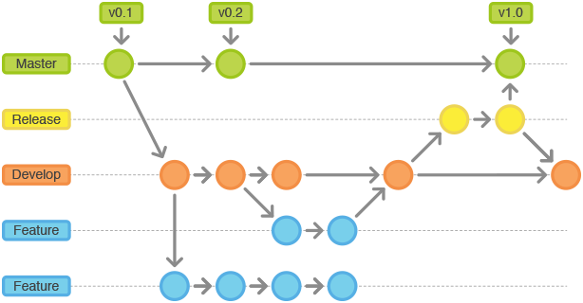
BRANCH

Slide 25
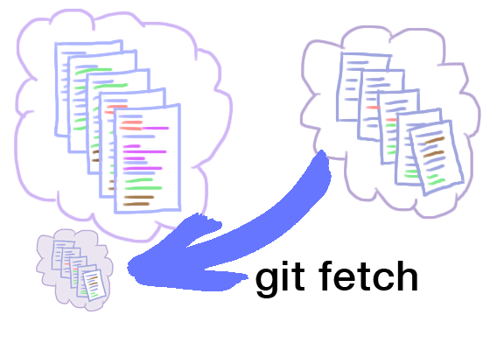
FETCH
$ git fetch <remote> <branch>
$ git fetch --all

Slide 26

PULL
$ git pull
$ git pull <remote>
Notes:
Fetch from and integrate with another repository or a local branch
Incorporates changes from a remote repository into the current branch
More precisely, git pull runs git fetch with the given parameters and calls git merge to merge the retrieved branch heads into the current branch.

Slide 27
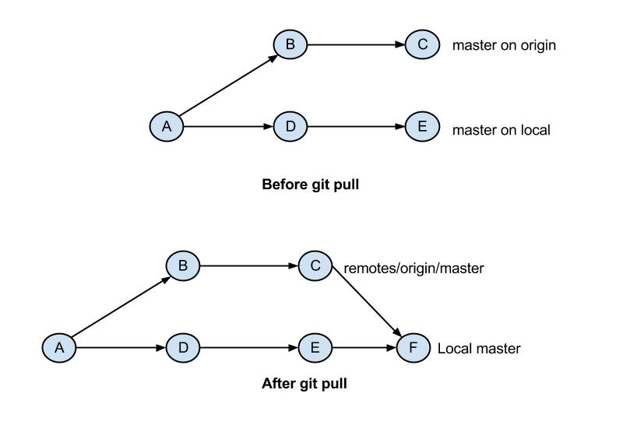
PULL
Notes:
Fetch from and integrate with another repository or a local branch
Incorporates changes from a remote repository into the current branch
More precisely, git pull runs git fetch with the given parameters and calls git merge to merge the retrieved branch heads into the current branch.

Slide 28
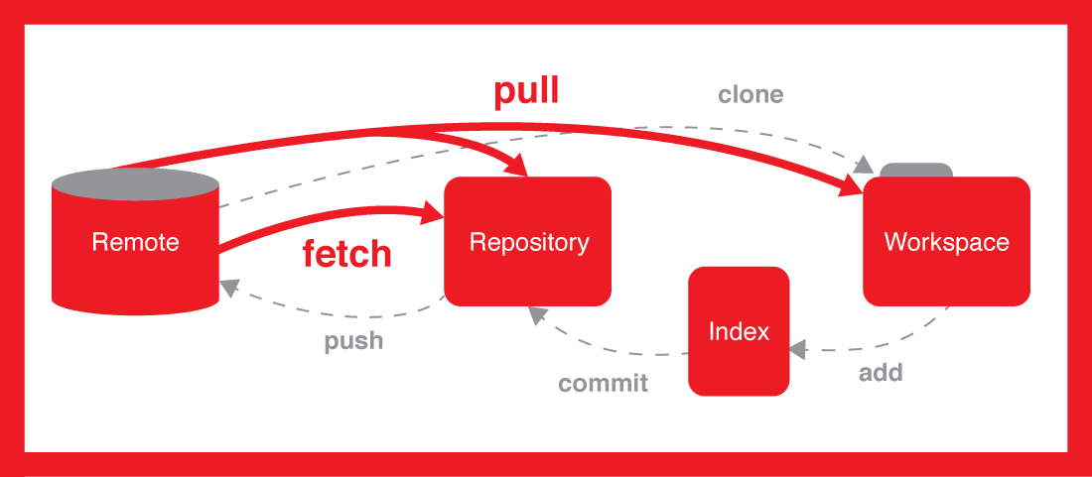
FETCH AND PULL
Fetch:
Copy changesets from a remote repository instance to a local one
Pull:
Perform fetch
Update the working copy
Notes:
Download objects and refs from another repository

Slide 29
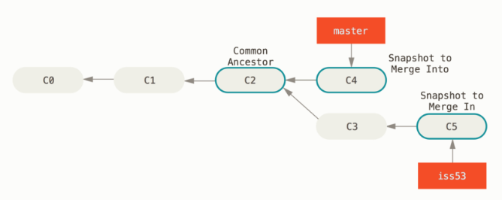
MERGE
$ git checkout master
Switched to branch 'master'
$ git merge iss53

Slide 30
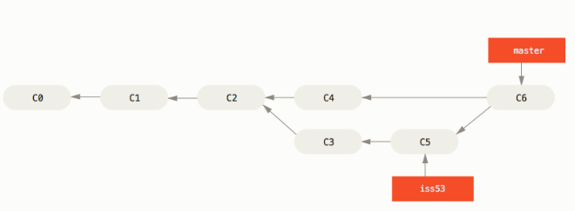
MERGE

Slide 31
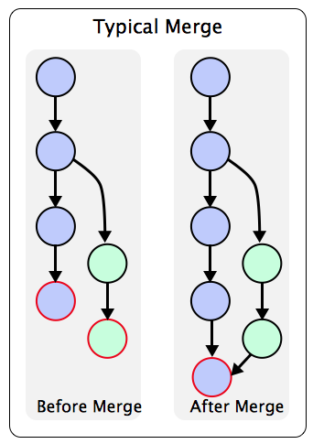
MERGING
$ git merge <branch>

Slide 32
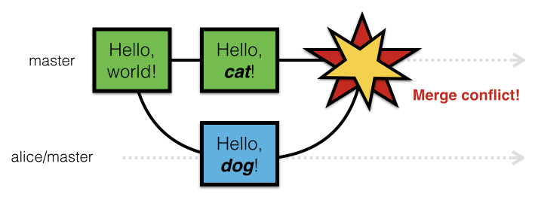
MERGE CONFLICT

Slide 33
MERGE CONFLICT
Kevin
Alice
Central
Server
Push
Pull
Push
Pull
Central
Server
Central
Server
Commit
Update
Commit
Update
-14:35: Kevin push his changes
-After some time, Alice pulls the Kevin’s changes
-But something goes wrong

Slide 34
MERGE CONFLICT
¡Merge with conflicts!
From http://centralserver.com/myprojectb19f36cb77378f master->origin/master Auto-merging main.rb CONFLICT (content): Merge conflicto in main.rb Automatic merge failed; fixconflicts and then commit the result.
Git includes both Kevin’s code and Alice’s Code like below
<<<<<<HEAD Kevin’s code here
=========
Alice’s code here
>>>>>>>19f36cb77378f

Slide 35
MERGE CONFLICT
Kevin
Alice
Central
Server
Push
Pull
Push
Pull
Central
Server
Central
Server
Commit
Update
Commit
Update
After (manually) resolving these conflicts, Alice is able to push the changes
git push

Slide 36
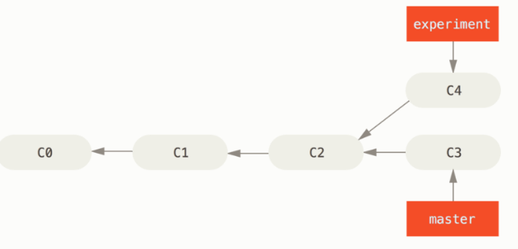
REBASING
$ git checkout experiment
$ git rebase master

Slide 37
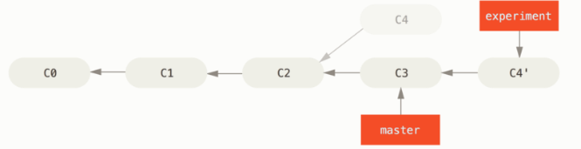
REBASING
$ git checkout master
$ git merge experiment

Slide 38
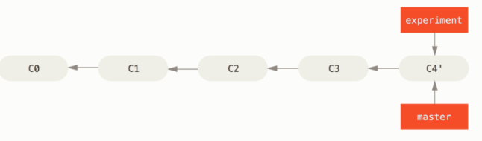
REBASING
The history is lost !!!

Slide 39

INTERACTIVE REBASING
“Please rebase on top of master and we’ll merge your pull request”.
“Can you please squash your commits together so we get a clean, reversible git history?”.
“Can you rewrite your commit’s message to describe better the problem it solves, and how it solves it?”.

Slide 40
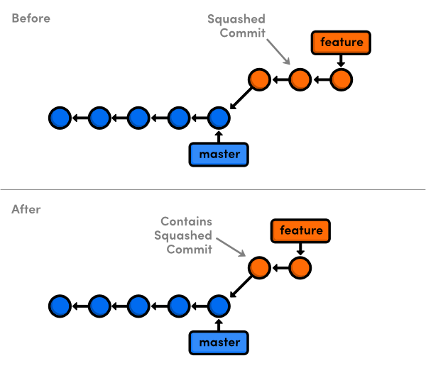
INTERACTIVE REBASING
--interactive (-i for short), which will open an editor with a list of the commits which are about to be changed. This list accepts commands, allowing the user to edit the list before initiating the rebase action.

Slide 41
INTERACTIVE REBASING
a1b8gte
b1b8la9
e30213
c38762
d60c81
d70c40
db51f4
f43402
a53904
b1

Slide 42
INTERACTIVE REBASING
Pick d70c40 Message for commit #1
Pick db51f4 Message for commit #2
Pick f43402 Message for commit #3
Oldest
Pick
Reword
Squash
fixup
Newest

Slide 43
INTERACTIVE REBASING
Master
a1b8gte
b1b8la9
e30213
c38762
d60c81
d70c40
b1

Slide 44
MERGE VS REBASE
MERGE
When finishing a feature branch merge the changes back to develop
When pulling changes from origin/develop onto your local develop
Newer
Don’t create a new commit
Create a new commit
Older
Maintain the history
REBASE
Lost the history

Slide 45
CHERRY PICK
Cherry picking in Git means to choose a commit from one branch and apply it onto another.
This is in contrast with other ways such as merge and rebase which normally apply many commits into another branch.
Make sure you are on the branch you want to apply the commit to.
$ git checkout master
Execute the following:
$ git cherry-pick m<commit-hash>
…

Slide 46
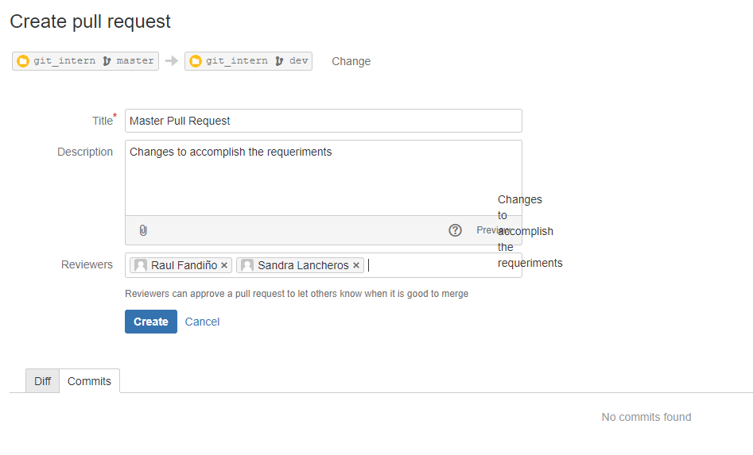
PULL REQUEST
Pull requests let you tell others about changes you've pushed to a repository

Slide 47
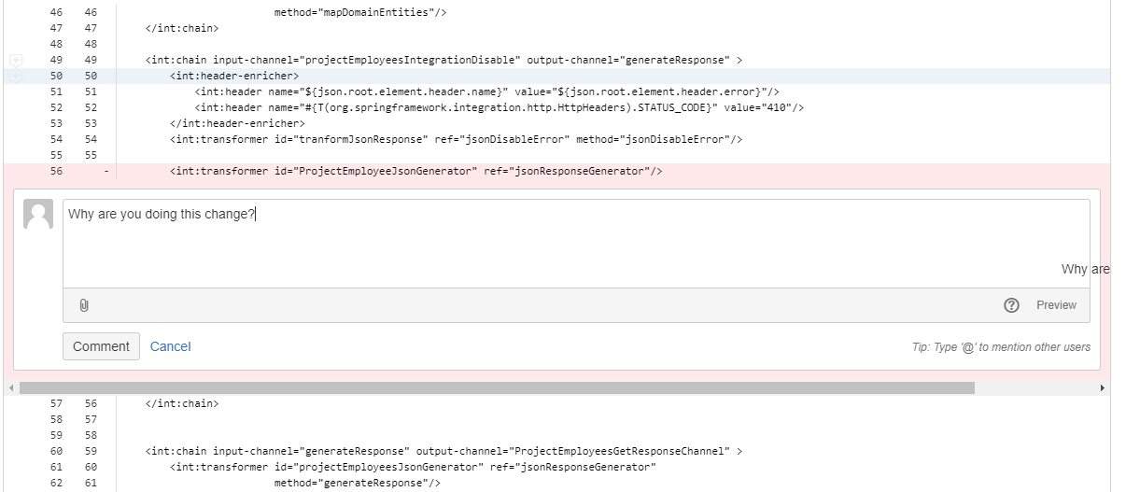
PULL REQUEST
Once a pull request is opened, you can discuss and review the potential changes with collaborators

Slide 48
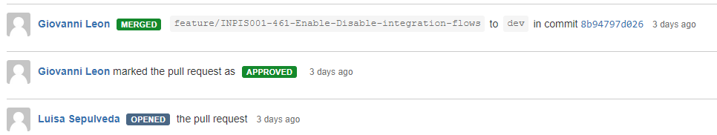
PULL REQUEST
Add follow-up commits before the changes are merged into the repository.

Slide 49

PREGUNTAS

Slide 50
MUCHAS GRACIAS!
GABRIEL GIRI
gabriel.giri@endava.com

